Slide 1
Juvenile Justice System
SS8CG6

Slide 2
Can we avoid going to trial??
Are there Peaceful Solutions??
http://www.gpb.org/georgiastories/stories/cops_and_robbers

Slide 3
What Rights Do Juveniles Have???
Are these right different from Adults?

Slide 4
Deliquent & Unruly Behavior - Juveniles
Delinquent Behavior
Criminal based on adult law
theft, assault, possession of drugs, rape, and murder.
If the act is serious enough, the juvenile may be charged as an adult and be subject for adult penalties
Unruly Behavior
Not a criminal based on adult law.
possession of alcohol or cigarettes, leaving home without permission of their parents or guardians, breaking curfew, skipping or not attending school (truancy), driving without a license, or not abiding by the reasonable commands of parents or other adults.
If a child commits these acts, they may be placed in a juvenile detention center.

Slide 5
Juvenile Rights – When in custody
Probably Cause is all that is needed
The right to have a parent or guardian present before they can be questioned by authorities
The right not to have their names or photographs made public
The right to two phone calls (parent and attorney)
The right to not self-incriminate and to be counseled on what self-incrimination is
The right not to be placed with adult offenders
The right for parents to be contacted immediately

Slide 6
Steps in the Juvenile Justice Process
Intake Officer
Brought to an intake officer who decides if there is enough evidence to make a charge against them.
Disposition Hearing
Judge hears witnesses and determines the punishment for the juvenile.
Adjudicatory Hearing
The judge determines the juvenile’s guilt or innocence. Juries do not hear juvenile cases.
Release or Detained
If not enough evidence; released to their parents/guardian;
If there is enough evidence, they are held in a youth detention center or adult prison depending on the crime.
If detained, there must be a hearing within 72 hours to determine if proceedings should continue
Sentencing
The judge rules on the juvenile’s punishment, which can include boot camp, probation, the youth detention center, fines, and/or mandatory counseling and school attendance.
Appeal
The juvenile can appeal the ruling if there is enough evidence to prove that they were innocent.
Informal Adjustment
(optional if a juvenile is a first time offender)
Must admit guilt to the judge & is under the supervision of the courts for 90 days.

Slide 7
The Seven Most Serious Delinquent Behaviors
There are seven specific offenses that, if a child between the ages of 13-17 commits, will be tried as an adult
Murder
Voluntary manslaughter
Rape
Aggravated sodomy
Aggravated child molestation
Aggravated sexual battery
Armed robbery with a firearm

Slide 8
Each offense is under the jurisdiction of the state Superior Court
Juveniles will be charged as an adult.
If sentenced the child may go to a juvenile detention center until old enough to be placed in an adult prison.
There are also offenses where the juvenile court can determine if a child should be charged as a juvenile or an adult. This can be:
If age 15 & is charged with a delinquent act; or
If age 13 or 14 & committed an act where the punishment would be the death penalty or life imprisonment for an adult.
If the child commits one of these offenses, then a hearing is called to determine if the child will be tried in a juvenile or Superior court.

Slide 9
Criminal Justice and the Juvenile Georgia Stories:
http://www.gpb.org/georgiastories/stories/criminal_justice_and_the_juvenile

Slide 10
Civil
Adult Justice System
Criminal
Felonies
Serious crimes
Arson, murder, rape, cruelty to animals, and grand theft.
Minimum sentence is no less than one year in jail.
Capital crimes.
Punishable by death crimes include murder, kidnapping with bodily injury, aircraft hijacking, and treason.
Misdemeanors
Less serious
Assault and battery, shop lifting, and trespassing.
Punished with less than a year in prison and a fine.

Slide 11
Criminal Law
Civil Law
Deal with relationships amongst individuals or groups.
Involves compensation based on injury or wrong doing.
TORT: A civil wrong doing against an individual
Note: A person can be charged with both criminal and civil wrong doing for the same action.
For example a person can be acquitted of murder in his/her criminal case and can also be found guilty of wrongful death and ordered to pay damages in his civil trial.
Protect society from wrong-doers.
Punishable with fines, community service, prison, and sometimes even death.

Slide 12
On a piece of paper, put these in order:
Booking
Jury Deliberation
First Appearance
Preliminary Hearing
Presentation of Evidence
Appeal
Grand Jury
Assignment before Superior Court
Arrest
Admission of Guilt / Plea Bargain
Sentencing
Selecting Jury
Opening Statement
Closing Statement

Slide 13
Pretrial Process
Arrest
Evidence
Taken into Custody
Booking
Official Arrest
Local Jail
Preliminary Hearing
Magistrate Judge
Was Crime Committed
Probable Cause of involvement
1st Appearance
Magistrate Ct
Explain Charges
Released on Bail
Grand Jury Indictment
Citizens make up Jury
Determine Guilt / Innocence
If Suspect claims not guilty; goes to trial
Assignment b/4 Superior Court
Suspect Arraigned before judge
Official statement of guilt / innocence
Admitting Guilt / Plea Bargaining

Slide 14
Trial Process
Closing Statement
After all evidence and witnesses have spoke, both attorneys present their final argument
Presentation of Evidence
Witnesses give testimony
Starts with Prosecutor
Defense cross examines witnesses
Jury Deliberation
Discuss defendant’s guilt / innocence
If not guilty – defendant is released
If guilty – defendant receives sentence
Sentencing
If guilty, judge sentences defendant
Includes time in prison and/or fines
Selecting Jury
12 citizens
Questioned by Defense and Prosecutor and Judge
Appeal
If innocence is maintained or mistakes were made
Defendant can make appeal with appellate court
Appellate court will review case
If overturned – go back superior court for new trial
Opening Statement
Attorneys speak directly to jury to explain what they hope to prove

Slide 15
Foundations of Govt.
The Georgia Constitution is based on many of the same principles as the United States Constitution and is structured similarly.
It begins with a preamble and is followed by eleven articles that address the different branches and duties of government.

Slide 16
Preamble
Georgia’s preamble is a short paragraph that states the purpose of the constitution and gives the reasons for its existence.
Georgia’s Preamble:
“To perpetuate the principles of free government, insure justice to all, preserve peace, promote the interest and happiness of the citizen and of the family, and transmit to posterity the enjoyment of liberty, we the people of Georgia, relying upon the protection and guidance of Almighty God, do ordain and establish this Constitution.”

Slide 17
Articles
Article I – Bill of Rights
Article II – Voting and Elections
Article III – Legislative Branch
Article IV – Constitutional Boards & Commissions
Article V – Executive Branch
Article VI – Judicial Branch
Article VII – Taxation and Finance
Article VIII – Education
Article IX – Counties & Municipal Corporations
Article X – Amendments to the Constitution
Article XI – Miscellaneous Provisions

Slide 18
Separation of Powers
Like the government of the United States, Georgia’s government is divided into three different parts.
Each branch has a different role, which is called separation of powers.
The legislative branch (General Assembly) makes the laws that citizens must obey.
The executive branch (governor) is the head of the government who enforces the laws.
The judicial branch (courts) interprets the laws.

Slide 19
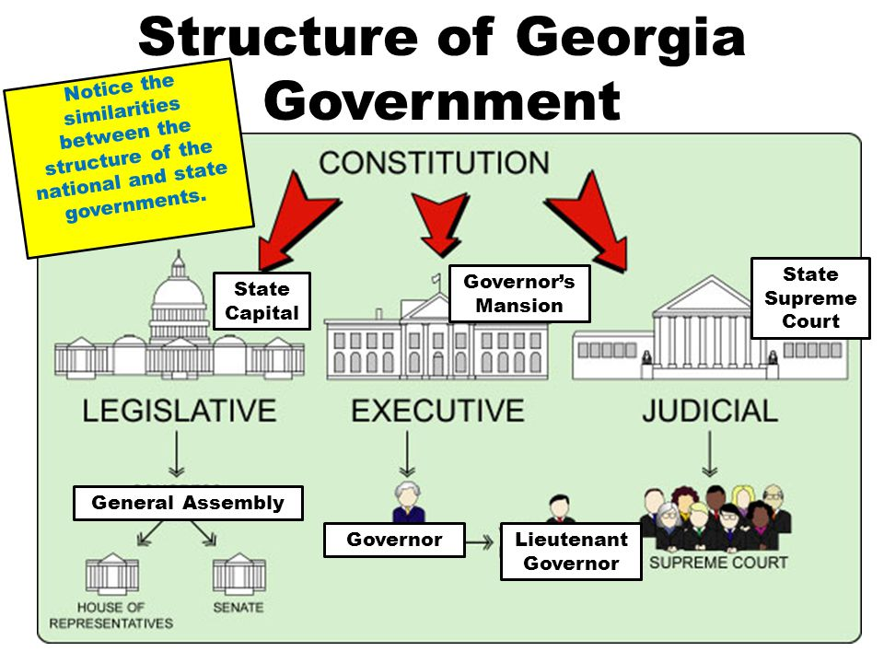

Slide 20
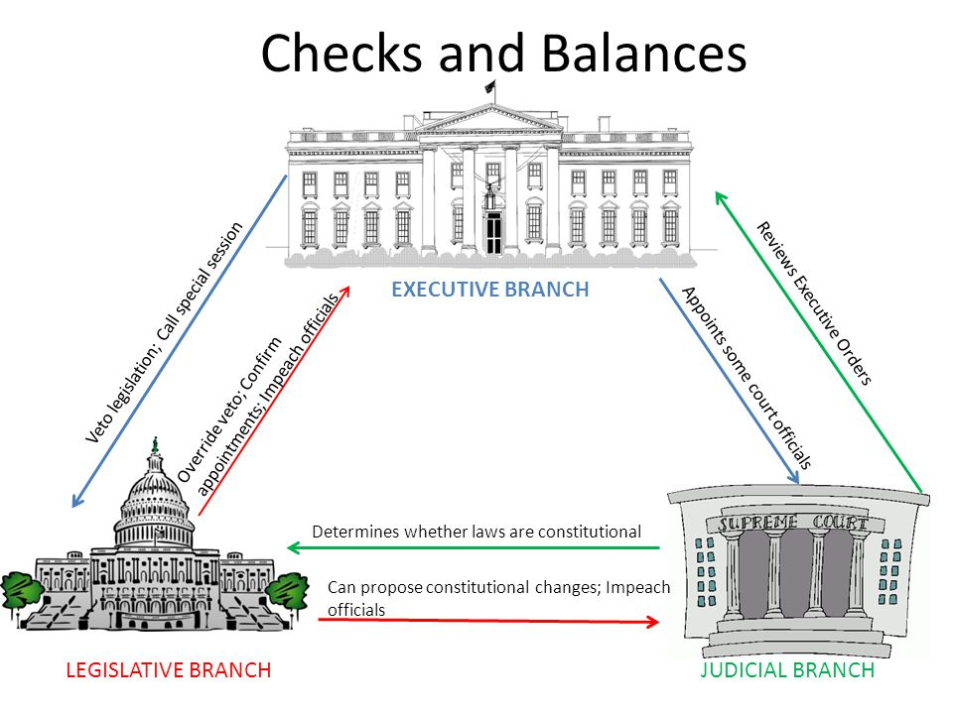

Slide 21
Rights &
Responsibilities
of Citizens

Slide 22
Rights
The US Constitution and the Georgia Constitution both give all citizens basic rights.
Rights are standards that keep institutions from harming people’s freedom.
The Bill of Rights in Georgia’s Constitution lists the rights of the citizens:
Right to freedom of speech and religion, right to keep and bear arms, right to trail by jury, right to a lawyer, etc.

Slide 23
Responsibilities
Along with rights come rules and responsibilities.
Laws made by the government protect people’s rights.
As citizens, we have responsibilities to take care of ourselves, respect the rights of others, and obey rules and laws.

Slide 24
Examples:
The Constitution grants the right to freedom of religion; however, worship must obey the laws of the state. It cannot be immoral or harm people.
It also grants the right to bear arms, but people must obey the laws that deal with owning and carrying guns.

Slide 25
2 Party System
There are two main political parties in the US: Democratic Party and Republican Party.
Although there are other parties, one of the two major parties usually controls the government (on a national level and in Georgia).
From time to time, people feel that neither party represents their ideas and third parties are formed to challenge the two major parties.
Third party candidates rarely win elections; however, they are valuable because they introduce new ideas or issues that should not be ignored.

Slide 26
Functions
Recruiting and nominating candidates
Educating voters about campaign issues
Helping candidates win the elections
Monitoring the actions of the elected official

Slide 27
The Pledge
In 1935, the Georgia legislature adopted the Pledge of Allegiance to the Georgia Flag.
“I pledge allegiance to the Georgia flag and to the principles for which it stands: Wisdom, Justice, and Moderation.”
The three important principles of the Pledge of Allegiance are the same ones displayed on the coat of arms.

Slide 28
3 Principles
Wisdom reminds the legislative branch to be wise in creating laws.
Justice appeals to the judicial branch for fair and just decisions.
Moderation urges the executive branch to carry out laws calmly within the boundaries of the law.

Slide 29
Organization of Executive Branch
Largest branch of Georgia’s government.
Governor is the highest position responsible for enforcing the law
Georgia Stories:
http://www.gpb.org/georgiastories/stories/executive_branch

Slide 30
Executive Offices
Governor |  | Lieutenant Governor
30 years old Resident of GA for six years U.S. citizen for 15 years | Qualifications | 30 years old Resident of GA for six years U.S. citizen for 15 years
Two 4 year terms | Term | 4 year terms (unlimited)
Every 4 years (even numbered years) | Election | Every 4 years (even numbered years)
Oversees operation of executive branch Chief law enforcement officer Commander-in-chief of state’s military Proposes annual budget Recommends new laws Gives “state of the state” address Fills government vacancies Call special sessions of the General Assembly | Formal Powers | Presides over the Senate Acts as the state’s chief executive when the governor is out of the state.
Serves as spokesperson for the state of GA Leads trade delegations Serves as party head Issues proclamations | Informal Powers | N/A

Slide 31
Fulfilling its role through agencies
Dept of Education
-Founded in 1870
-oversees public education
-ensure “education-related laws are obeyed
-state and federal funds are properly allocated
Dept of Public Safety
-Created in 1937
-Protect citizens and their property.
-Include the Georgia Highway Patrol, the Capitol Police, and the Motor Carrier Compliance Division.
Dept of Economic Development
-Bring economic development
-Promotes Georgia as a “go-to location for film, music, digital entertainment, and the arts.”
Reports to
Governor
Dept of Transportation
-Role in all four of the major transportation systems
-Responsible for planning, constructing, and maintaining Georgia’s roads and highways.
-Eight offices throughout the state.
-(HERO) trucks that quickly respond to highway accidents and stranded motorists.
Dept of Natural Resources
-Administer and enforce laws that relate to natural resources; (rivers and lakes).
-Operates Georgia’s state parks
-Preserves the state’s historical sites.
-Enforcing hunting, fishing, and boating laws.

Slide 32
Article III They make our laws
General Assembly (Bicameral)
House of
Representatives
Senate

Slide 33
Members of the General Assembly Qualifications, Term, Election, and Duties
 | Georgia State Senate Member | Georgia State House of Representative Member
Qualifications | -25 years old -Resident of GA for two years -Resident of the district for at least one year -U.S. citizen | -21 years old -Resident of GA for two years -Resident of the district for at least one year -U.S. citizen
Terms | 2 years | 2 years
Election | -November, even numbered years | -November, even numbered years
Duties | -Serving on standing committees -Pass state’s operating budget -Enacting laws -Redistricting (every 10 years) -Vote to place Constitutional Amendments on the election ballot (2/3 vote) | Serving on standing committees -Pass state’s operating budget -Enacting laws -Redistricting (every 10 years) -Vote to place Constitutional Amendments on the election ballot (2/3 vote)

Slide 35
